Slide 1
Digital Portfolio
STUDENT NAME: Muthuselvan. M
REGISTER NO AND NMID: 222407872 and autunam1455ds242712
DEPARTMENT: B. Sc(Computer Science with Data science)
COLLEGE: COLLEGE/ UNIVERSITY: Tagore college of Arts and Science/
University of Madras

Slide 2
PROJECT TITLE
"Digital Portfolio – Showcasing My Web Development Journey"

Slide 3


AGENDA
Problem Statement
Project Overview
End Users
Tools and Technologies
Portfolio design and Layout
Features and Functionality
Results and Screenshots
Conclusion
Github Link
3/21/2024 Annual Review

Slide 4

PROBLEM STATEMENT
In today’s competitive digital era, individuals need a strong online presence to showcase their skills. Traditional resumes often fail to highlight creativity, projects, and technical expertise. Lack of a professional portfolio reduces visibility to recruiters and potential clients. The problem: How can a developer present their skills and projects effectively in a Modern

Slide 5

PROJECT OVERVIEW
The project is a personal digital portfolio website designed for Muthuselvan. Objective: To showcase academic background, technical skills, projects, and achievements in a visually appealing and accessible format. Includes sections: About, Skills, Projects, and Contact. Responsive design ensures usability on desktop, tablet, and mobile devices.

Slide 6

WHO ARE THE END USERS?
Recruiters & Hiring Managers - to evaluate skills and experience. Clients - looking for freelancers or developers for projects. Peers & Collaborators - students, colleagues, and mentors who may collaborate on future work. General Audience - anyone seeking inspiration for personal portfolio design.

Slide 7

TOOLS AND TECHNIQUES
HTML5 & CSS3 → For layout and styling. JavaScript → Interactive components and animations. Google Fonts & Responsive Design → Typography and accessibility. Unsplash Images → Aesthetic visuals. Python / C & C++ (optional mention) Highlighted as additional skills. ← GitHub → For version control and hosting source code.

Slide 8
POTFOLIO DESIGN AND LAYOUT
Modern Blue Theme → Professional, clean, and elegant. Typography Combination of Playfair Display, Inter, and Great Vibes. Grid Layout → Consistent alignment and spacing. Hero Section → Intro with personal tagline and call-to-action button. ← About Section Profile image with personal details. Skills Section → Visual cards for different technologies. Contact Section → Interactive details with email & phone.
8

Slide 9
FEATURES AND FUNCTIONALITY
Smooth navigation with sticky header and scroll behavior. Responsive design for all screen sizes. Highlight cards for skills and projects. Contact information integrated with clickable links (phone/email). Custom styled buttons and hover effects. Year in footer auto-updates with JavaScript.

Slide 10
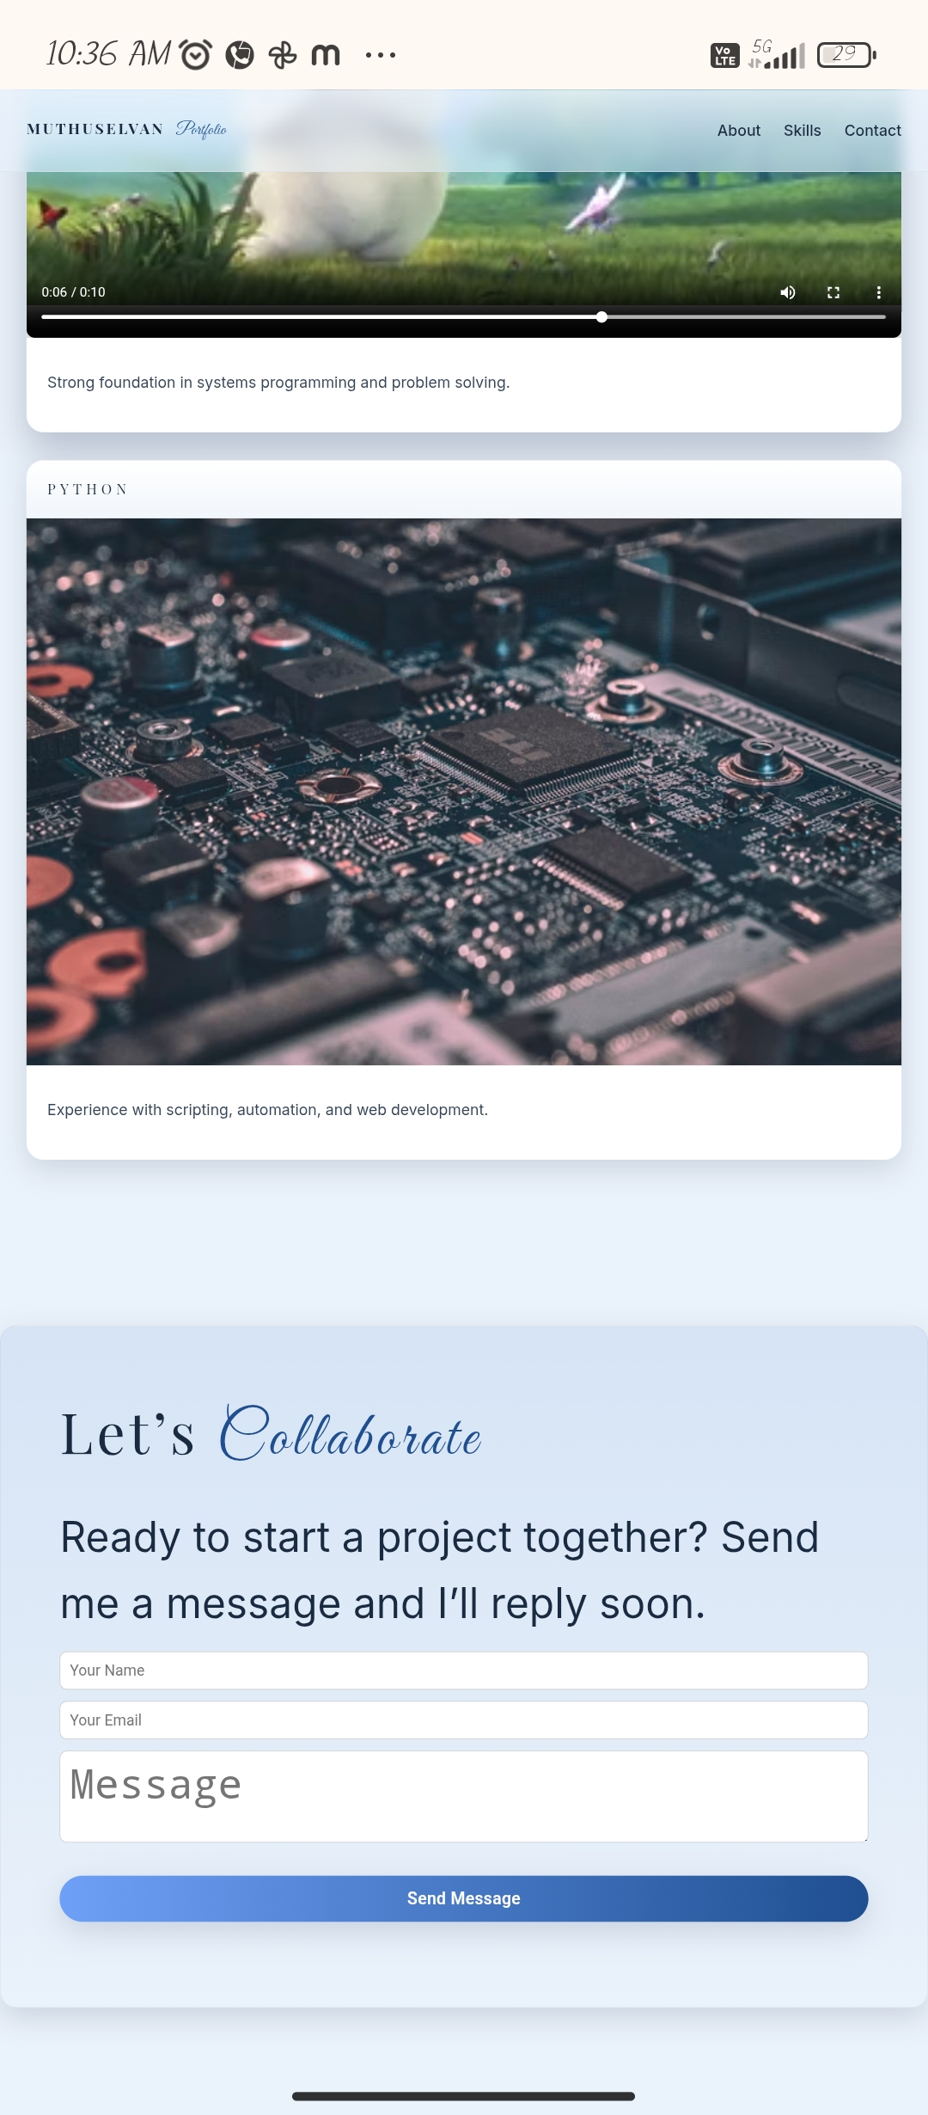
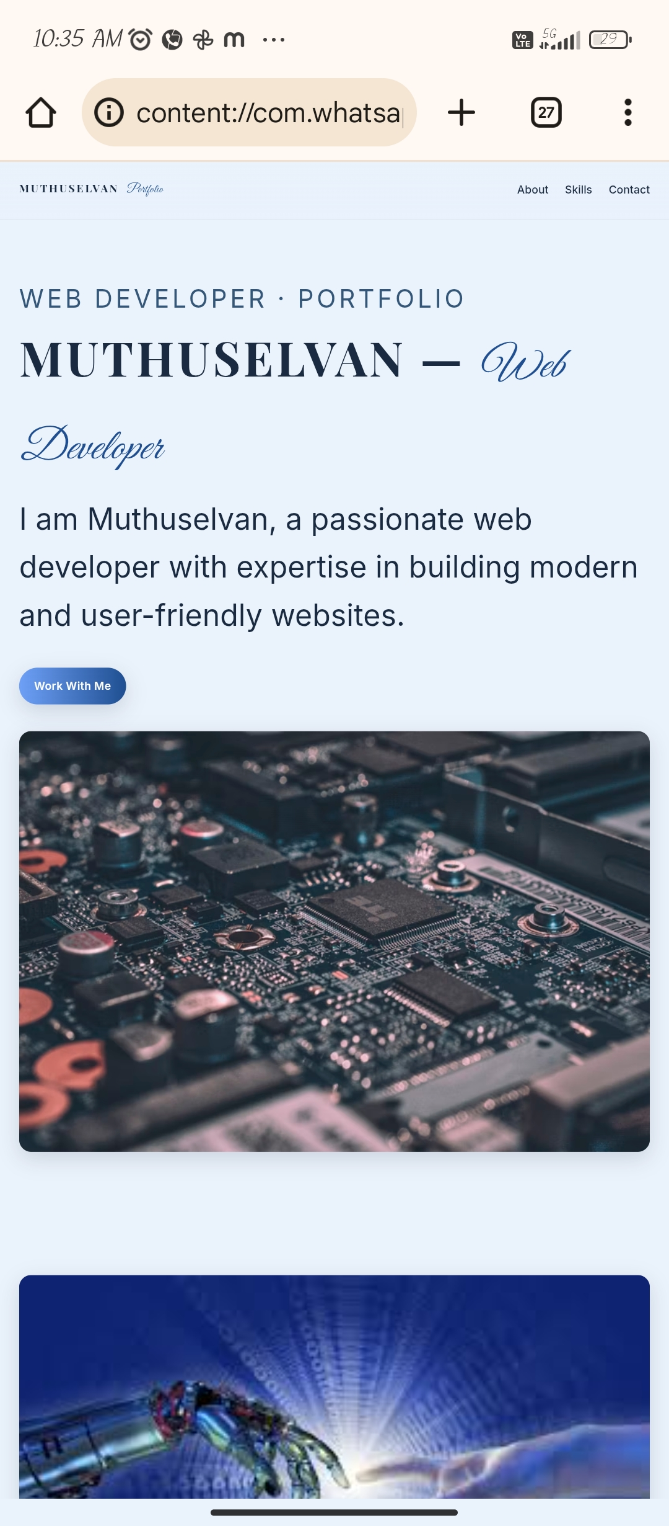
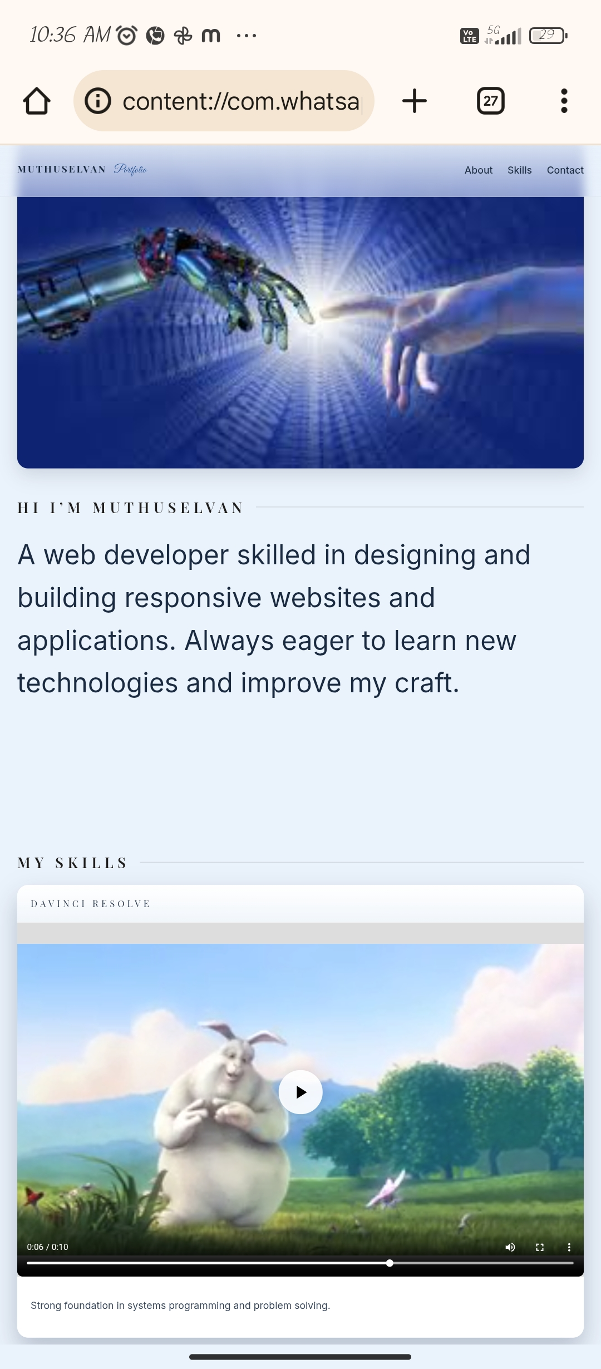

RESULTS AND SCREENSHOTS
3/21/2024 Annual Review
10

Slide 11
CONCLUSION
Developed a professional portfolio to improve online presence. Demonstrated web development skills in HTML, CSS, JavaScript, and UI/UX design. Portfolio helps recruiters and clients easily access information. Future Scope: Add blog section, integrate backend, or host live on GitHub Pages/Netlify.
11

